Slide 1
Dr. Şebnem Er
Introduction to Statistics

Slide 2
Course Content and Outline
Name of the course: INTRODUCTION TO STATISTICS
Credit: 3 credits
Lecture hours: 4 hours (2 Theoretical and 2 Applied)
Academic Year: 24 September 2012 – 4 January 2013
Holidays: 26th of October for Greater Eid and 1st of January 2013 for the New Year

Slide 3
Course Outline
week: Scientific research, importance of statistics and basic descriptions
week: Collecting data, types of data,
week: Describing data: Charts and graphics,
week: Descriptive statistics measures and importance,
week: Descriptive Statistics: Measures of central tendency,
week: Descriptive Statistics: Measures of central tendency,
week: Midterm,
week: Midterm,
week: Descriptive Statistics: Measures of dispersion,
week: Descriptive Statistics: Measures of kurtosis and skewness,
week: Introduction to probability-Joint, Marginal and Conditional Probabilities
week: Bayes and Binomial Distributions
week: Hypergeometric and Poisson Distributions
week: Probability distributions for continuous random variables – Normal and Exponential Distributions
week: Application of describing data and descriptive statistical measures with softwares.

Slide 4
How to be Successful in this Class?
Any ideas? Any students who are repeating the class?
Attend to both the Tuesday and Friday lectures.
The subjects are chained to eachother so when you miss one day then you will be in trouble!!!
As a result, be in good health, and be in the class.
Obviously not only be in the class but listen to me with your brains!
We will start at 3 pm on both Tuesday and Friday lectures. Be on time.
You can sit at all the lectures, learn every single bit of information off by heart and get 0 in the exam. Zero.
Repeat what we have done after and before the lectures.
Solve the questions given in the tutorial sheets before coming to the Friday lectures.
If you do all these I bet you would not need to work before the exams. Cos I know you are all clever students.
BUT!!!
If you want to fail, it is easy. Then do FAIL! Really easy. Though that would be a pity cos you would not be able to take the «Statistical Analysis» and therefore the «Business Statistics with Applications» courses. Ooops!!!
English!
One final note: Follow my website.

Slide 5
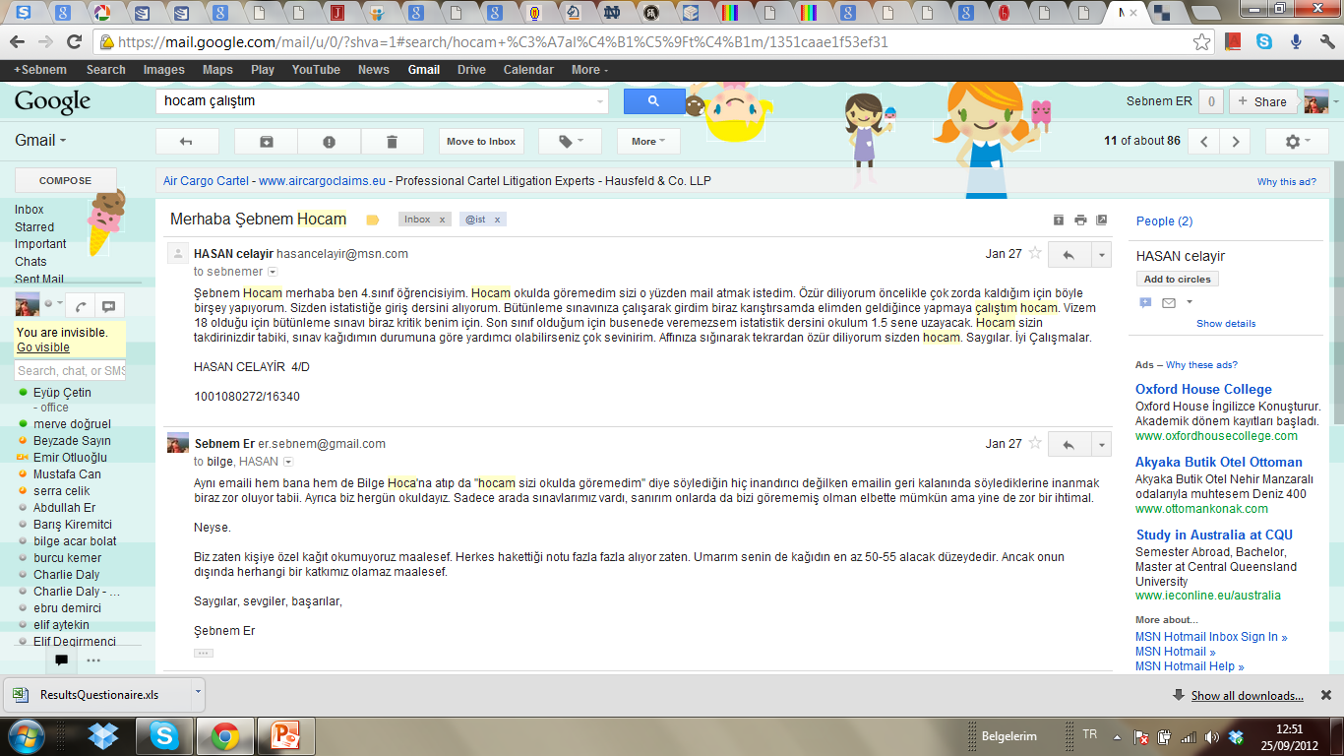
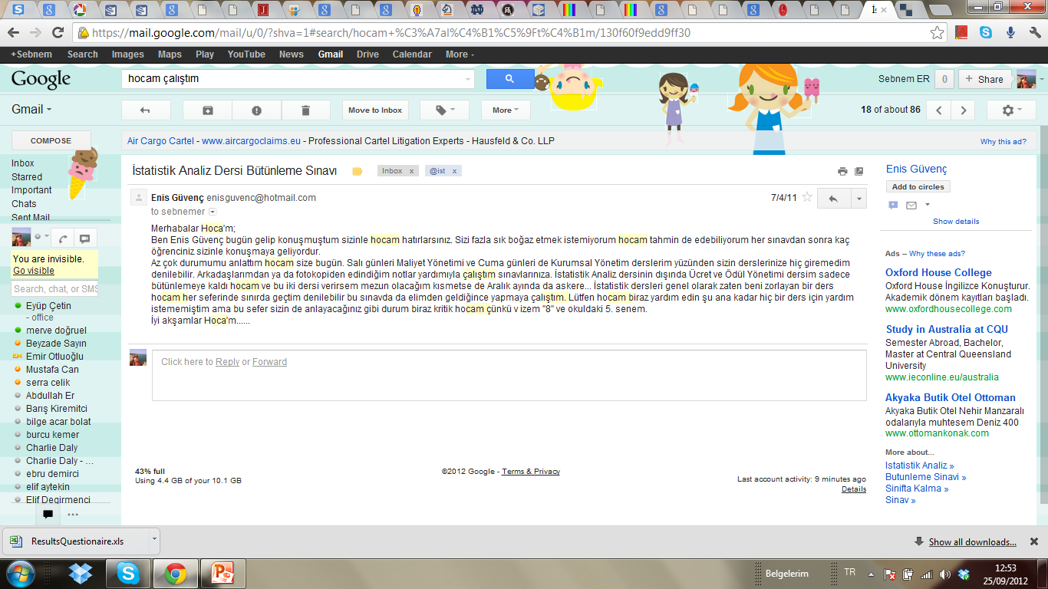
Do not send e-mails such as
They don’t work with me.
If you work enough you will pass this course.

Slide 6
Assessment Criteria and Textbook
Midterm Exam : %40 Final Exam : %60
Textbook and Resources :
David F. Groebner, et.all “A Course in Business Statistics with CD-ROM (4th Edition)”
Paul Newbold, William L. Carlson, Betty Thorne, Statistics for Business and Economics, 6th ed., New Jersey, Pearson Prentice Hall, 2007.
Berenson, M.L., Levine, D.M., Krehbiel, T.C., Basic Business Statistics Concepts and Applications, 11ty Edition, 2009
Any books that include the content of the course
Databases:İSO,DPT,İTO, TUİK, Central Bank of the Republic of Turkey, Istanbul Stock Exchange (ISE), World Bank, Eurostat, Gapminder etc...

Slide 7
How to Contact Me
e-mail:
sebnemer@istanbul.edu.tr
er.sebnem@gmail.com
No Facebook, LinkedIn or GooglePlus Please!
Use e-mail and I’ll respond to your e-mails ASAP.
Office Room:
1st Floor: Department of Quantitative Methods
Mondays and Thursdays: anytime between 10:00-16:00

Slide 8
LET US START!

Slide 9
Surrounded by Statistics
Let’s have a look at Prof. Hans Rosling’s
«The Joy of Stats» video.
Source: http://www.gapminder.org/videos/the-joy-of-stats/

Slide 10

The Joy of Stats

Slide 11
The Joy of Stats
If you want to watch the rest please check the website.
What did Prof. Rosling say?
«The world we live in is a wash with data that comes pouring in from everywhere around us. On its own, this data is just noise of confusion. To make sense of data, to find the meaning in it, we need a powerful branch of science: STATISTICS
Believe me there is nothing boring about Statistics, especially not today when we can make the data sing...»

Slide 12
As Prof. Rosling Says We Are Surrounded by Statistics
How are we surrounded by statistics? In which areas?
In Many areas:
AACSB accreditation questionaires
Medicine:
Economics
Food technologies
Supermarkets
Engineering
Air traffic control systems
Gambling
Management
Sports – Football, Basketball, Swimming etc. Coin toss before a match.
Spam Filtering – Google!
Customer Satisfaction
Detecting Credit Card Fraud
Crime Statistics

Slide 13
Surrounded by Statistics: In Medicine
Disease and mortality statistics :Understanding the processes by which plagues spread prevent them from decimating humanity:
Not far from London's Piccadilly Circus Underground Station, if you take a few steps from the intersection of Broadwick Street and Lexington Street, you will stumble into a tubewell (water pump). Notice, the pump has no handle!

Slide 14
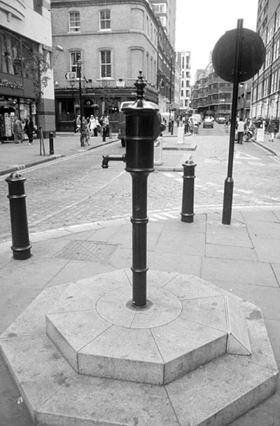

Slide 15
Start of cholera in London, 1854.
Now let us go back almost 160 years in time. It started in the early morning of Monday August 28, 1854 in the basement apartment.
There lived Sarah Lewis with her policeman husband Thomas and five-month old daughter.
The little girl started having diarrhea with its usual symptoms of vomiting, unable to keep down food or medicine, and passing pale, green slimy, watery, offensive-smelling stools. There were no disposable diapers those days. Mrs. Lewis cleaned infant daughter's soiled diapers in buckets of cold water that ran down the drain in front of the apartment. Just out Lewis' apartment, people gathered around a water pump to fetch water.
Over the next three days, people living nearby started to die as well as this little girl.
By the 7th day, September 3, there was full-edged cholera outbreak.
It was during this epidemic that John Snow, a London doctor, succeeded in tracing the epidemic to a single water pump on Broad Street in the Golden Square area.

Slide 16
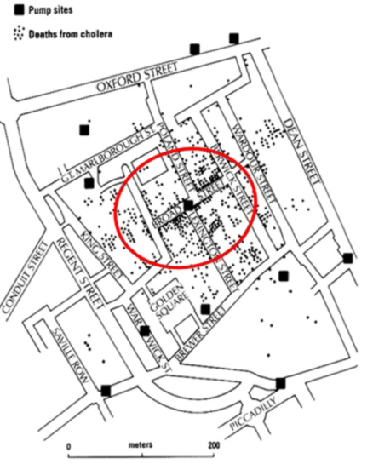
Snow and to the displeasure of the locals, a completely different kind of preventive measure was taken - the pump handle outside 40 Broad Street was removed on September 8. And immediately the number of new cases diminished.

Slide 17
Another Disease
River Blindness (Onchocerciasis): A parasitic disease caused by infection by roundworm mostly in mid-Africa.
Research ongoing by Peter J. Diggle and his team.
How do they map and assess the data?
Field work.

Slide 18
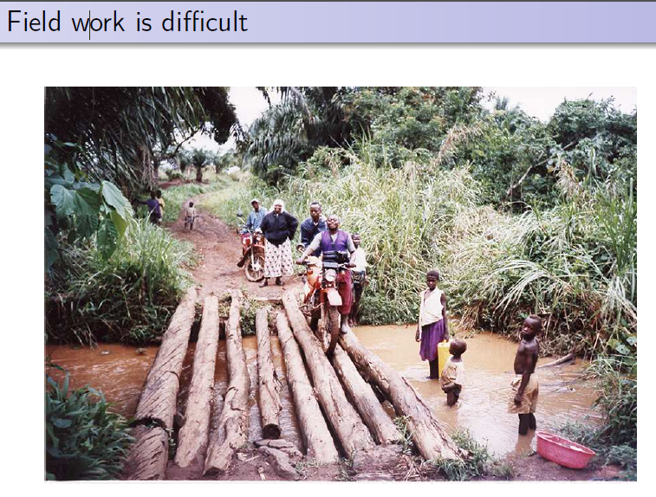
Rapid Assessment Procedure for loiasis

Slide 19
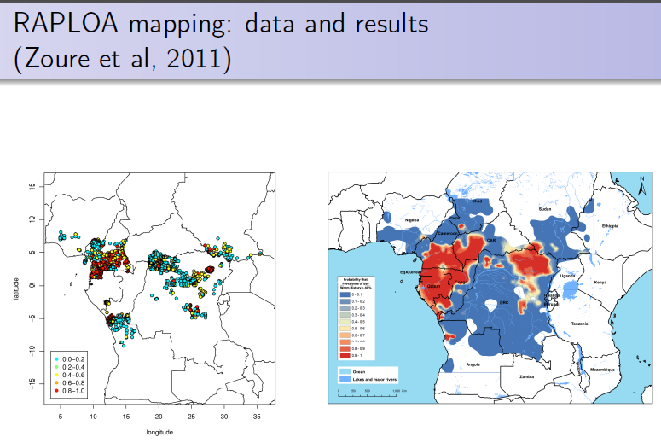

Slide 20
We are in the Business Faculty!
Think about business problems!
Where can we use data and decision methods in business?
Think!

Slide 21
Surrounded by Statistics: In Economics
Inflation
Economic Crisis
Economic Welfare
Income Distribution
Labour Statistics
Imports-Exports

Slide 22
Surrounded by Statistics
In Food Technologies: Decision of what to grow, how much to grow – demand/supply, at what temp, how to process the yield... etc.
In Supermarkets: How to package, shelve design, combination of products in shelves, distribution of the products, advertisements, promotions, public days, customer cards (MoneyCard etc.) ... etc.
In Engineering: Designing reliable computer systems and programmes... etc.
In Air Traffic Control Systems: These work in real time, collecting and processing data simultaneously.
In Gambling: Kemal Sunal’s film: Atla Gel Şaban ☺

Slide 23
Surrounded by Statistics
In Management: Decision making, predicting, visualising, interpreting the data of a department, corporation, production, personnel...
In Sports – Football, Basketball, Swimming etc.
In Spam Filtering – Google: Constructing spam filters which prevent obscene ads reaching your email inbox. They include things such as get-rich-quick schemes, prescription drugs, stock market tips, and dubious sexual aids. One estimate is that over 90 billion spam messages are sent each day – increases every day. The techniques behind the principles of preventing spam is based on statistics-probability.
In Customer Satisfaction: Surveys to learn the satisfaction level of our customers. Are they happy with the product or not?

Slide 24
Surrounded by Statistics
In Detecting Credit Card Fraud: Fraudulent transactions cost the bank money, and also cost the bank’s customers money. They have to be detected and prevented. Use statistics.
In Bus Arrival Times: IETT
In Crime Statistics: The City of Columbia, South Carolina crime map:
http://www.spotcrime.com/sc/columbia

Slide 25
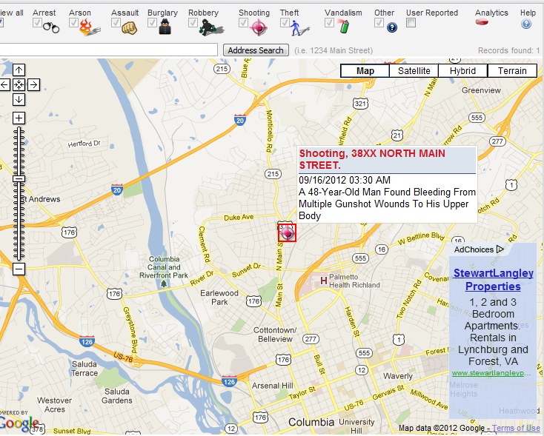
Surrounded by Statistics

Slide 26
Clear enough? We need Statistics!
I hope that it is clear that statistics is ubiquitous, in that it is applied in all walks of life.
Therefore, it is clearly important that no educated citizen should be unaware of basic statistical principles.

Slide 27
But, What is Statistics?
There are many descriptions:
Technology of extracting meaning from data
Methods used to collect, process, interpret data
Technology of handling uncertainty
Predicting the future or for making inferences about the unknown, or for producing convenient summaries of data
A statistic is a numerical fact or summary
Statistics is the scientific method in action – investigation.
Science dealing with data about the condition of a state or community

Slide 28
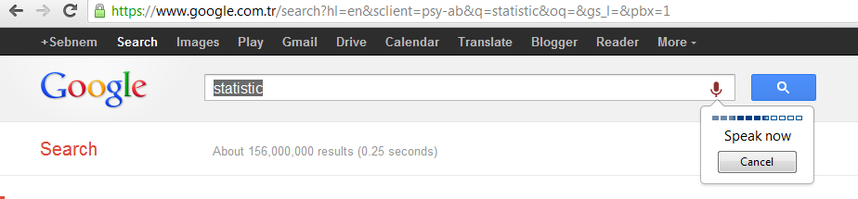
DATA
As obvious, statistics begins with data.
Data are typically numbers: the results of measurements, counts or other processes.
Data could be in the form of pictures, words, or even things such as electronic or acoustic signals: Google search by image, voice!

Slide 29
DATA
Data is evidence.
Without data, our ideas and theories about the world around us are mere speculations.
Data provide a grounding, linking our ideas and theories to reality, and to validate and test our understanding.

Slide 30
Tools of Statistics
Descriptive statistics
Collecting, presenting, and describing data
Inferential statistics
Drawing conclusions and/or making decisions concerning a population based only on sample data

Slide 31
Descriptive Statistics
Collect data
e.g. Survey, Observation,
Experiments
Present data
e.g. Charts and graphs
Characterize data
e.g. Sample mean =

Slide 32
Descriptive Statistics
Collect data
e.g. Survey, Observation,
Experiments
When collecting data, we need to take special care to ensure that they do cover the aspects we are interested in, or about which we wish to draw conclusions.

Slide 33
Descriptive Statistics
Data has 2 aspects
One aspect is concerned with the objects we wish to study
Second aspect is concerned with the characteristics of those objects we wish to study.
e.g. Objects might be students in Business Faculty. We might be interested in their success levels in Maths module in which the characteristics will be the marks obtained in Maths module.
In Statistics, we call the characteristics variables, with each object having a value of a variable.

Slide 34
Data Types
Data
Qualitative
(Categorical)
Quantitative
(Numerical)
Discrete
Continuous
Examples:
Marital Status
Political Party
Eye Color
(Defined categories)
Examples:
Number of Children
Defects per hour
(Counted items)
Examples:
Weight
Voltage
(Measured characteristics)

Slide 35
Data Types
Time Series Data
Ordered data values observed over time
Cross Section Data
Data values observed at a fixed point in time

Slide 36
Data Types
 | Sales (in $1000’s)
 | 2003 | 2004 | 2005 | 2006
Atlanta | 435 | 460 | 475 | 490
Boston | 320 | 345 | 375 | 395
Cleveland | 405 | 390 | 410 | 395
Denver | 260 | 270 | 285 | 280
Time Series Data
Cross Section Data

Slide 37
Data Measurement Levels
Numbers are universal and although they have only one property, their numerical value, we might choose to use that property in different ways.
Student success: We might rank the marks, because we are interested in only whether one mark is higher than another. When we are interested in only with the order of the values in this way, we say we are treating the data as lying on an «ordinal» scale.
QS World University Rankings: http://www.youtube.com/watch?v=ACwl4oeGssc
IU (501-550). Check out the first 10.
When a farmer measures the amount of corn she has produced, she does not want to know whether she has grown more than last year. She wants to know how much she has produced: its actual weight. She compares the weight of corn with a standard weight, such as a ton (ratio of the weight of the corn the farmer has produced to the weight of one ton of corn). When we use the values in this way, we say we are treating the data as lying on a «ratio» scale.
When we are interested in the number of girls and boys in a class, we simply count discrete well-defined units (students). Here we treat the data as lying on an «absolute-nominal» scale.

Slide 38
Data Measurement Levels
Highest Level
Complete Analysis
Measurements
Ratio/Interval Data
Rankings
Ordered Categories
Higher Level
Mid-level Analysis
Ordinal Data
Categorical Codes ID Numbers Category Names
Lowest Level
Basic Analysis
Nominal Data

Slide 39


Data Sources
Primary
Data Collection
Secondary
Data Compilation
Print or Electronic
Observation
Survey
Experimentation

Slide 40
Data Quality
A researcher has to collect good data.
There is saying by Ronald A. Thisted:
Raw data, like raw potatoes, usually require cleaning before use.
Data provide a window to the world, but it is important that they give a clear view. No scratches, distortions on the glass or blurred view is acceptable.
Why?
These might lead us to mistaken conlcusions, wrong policy, lies and etc.
Data should be representative of the overall population.
Incomplete questionnaires with missing data is a big trouble.
The questions and the expressions should be clear enough for not to cause any misconceptions.
If the data is gathered by Primary Sources, then the researcher has to follow a few steps.

Slide 41
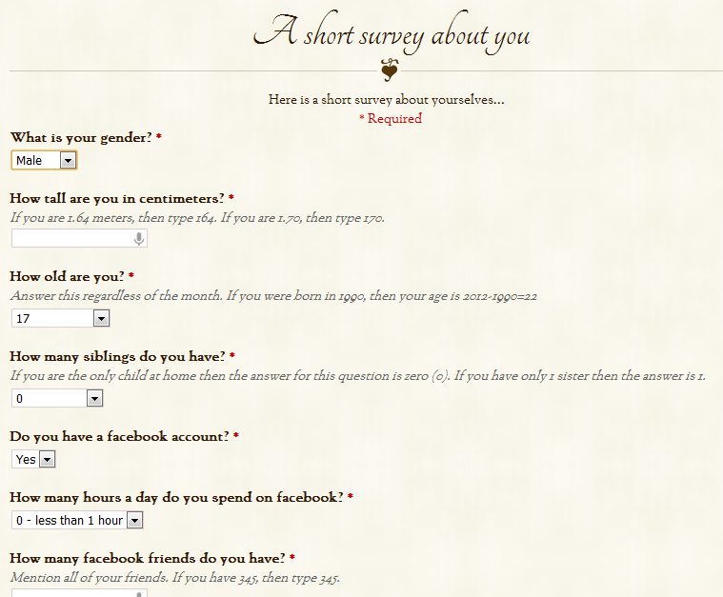
SEE YOU ON FRIDAY
Check my website.
Go to Tutorial Material 1
Please fill in the short survey.

Slide 42
What we learned on Tuesday
Why we need Statistics
Meaning of
Statistics
Data
Tools of Statistics
Descriptive
Inferential
Data Types
Qualitative / Quantitative
Data Measurement Levels
Nominal / Ordinal / Ratio

Slide 44
LET US CONTINUE WITH THE STEPS OF A SURVEY

Slide 45
Survey Design Steps
Define the issue
what are the purpose and objectives of the survey?
Define the population of interest
Formulate survey questions
make questions clear and unambiguous
use universally-accepted definitions
limit the number of questions

Slide 46
Survey Design Steps
(continued)
Pre-test the survey
pilot test with a small group of participants
assess clarity and length
Determine the sample size and sampling method
Select Sample and administer the survey

Slide 47
Types of Questions
Closed-end Questions
Select from a short list of defined choices
Example: Major: __business __liberal arts
__science __other
Open-end Questions
Respondents are free to respond with any value, words, or statement
Example: What did you like best about this course?
Demographic Questions
Questions about the respondents’ personal characteristics
Example: Gender: __Female __ Male

Slide 48
ESS
http://www.europeansocialsurvey.org/
The European Social Survey (the ESS) is an academically-driven social survey designed to chart and explain the interaction between Europe's changing institutions and the attitudes, beliefs and behaviour patterns of its diverse populations. The ESS was established in 2001, and was led by its founder and coordinator Roger Jowell until his death in December 2011.
The questionnaire:
And the data from that in Excel format

Slide 49
Sampling
Is it possible to collect data from the entire population? (census)
If yes, then we can talk about what is true for the entire population
Often we cannot (time/cost)
If no, we can use a smaller subset:
A SAMPLE

Slide 50
Populations and Samples
A Population is the set of all items or individuals of interest
Examples: All likely voters in the next election
All parts produced today
All sales receipts for November
A Sample is a subset of the population
Examples: 1000 voters selected at random for interview
A few parts selected for destructive testing
Every 100th receipt selected for audit
A Sampling Frame is a list from which to select your sample

Slide 51
Population vs. Sample
Population
Sample
a b c d
ef gh i jk l m n
o p q rs t u v w
x y z
b c
g i n
o r u
y

Slide 52
Population vs. Sample
Parameter :
Characteristic of the population
Statistic:
Characteristic of a sample

Slide 53
Why Sample?
Less time consuming than a census
Less costly to administer than a census
It is possible to obtain statistical results of a sufficiently high precision based on samples.
A census may be destructive destroying all we produce or have.
Difficult to obtain and measure every item in a population: geographically distributed.

Slide 54
What is the Aim of a Sample?
Aim is to make statements based on a sample data that have some validity about the population at large.
Therefore we need a sample that is REPRESENTATIVE of the population.
HOW?

Slide 55
How Do We Sample?
Sample design:
Methods of sampling
Random or
Non-random sampling methods
In order to be REPRESENTATIVE, the sample selection process should be based on RANDOMNESS

Slide 56
How many do we sample?
To determine the size for a planned sample, importance should be given to the
required precision,
error of estimation,
costs of sampling,
the financial resources as well as
the time available for the survey.

Slide 57
Sampling Techniques
Samples
Non-Probability (non-random) Samples
Probability (random) Samples
Simple
Random
Systematic
Judgement
Convenience
Cluster
Stratified

Slide 58
Random Sample
A random sample allows us to make estimates about the larger population based on what we learn from the subset (sample)
Advantages
Eliminates selection bias
Able to generalize to the population
Cost-effective

Slide 59
Types of Random Sampling
Items of the sample are chosen based on known or calculable probabilities
Probability (random) Samples
Simple
Random
Stratified
Systematic
Cluster

Slide 60
Simple Random Sample
Simplest and has 2 properties
Every individual or item from the population has an equal chance of being selected (unbiased)
Selection of one unit has no influence on the selection of other units (independence)
Selection may be with replacement or without replacement
Samples can be obtained from a table of random numbers or computer random number generators
Establish a sample size and proceed to randomly select units until we reach the sample size.

Slide 61
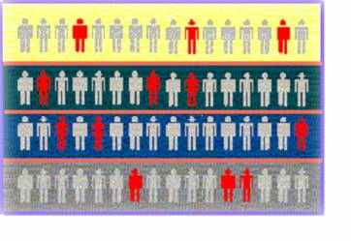

Stratified Random Sample
Use when specific groups must be included that might otherwise be missed by using a simple random sample.
Population divided into homogeneous subgroups (called strata) according to some common characteristic
Simple random sample selected from each subgroup
Samples from subgroups are combined into one
Population
Divided
into 4
strata
Sample

Slide 62
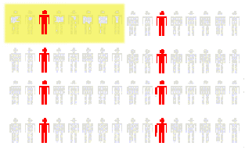
Systematic Samples
Decide on sample size: n
Divide frame of N individuals into groups of k individuals: k=N/n
Randomly select one individual from the 1st group
Select every k^{th} individual thereafter
N = 64
n = 8
k = 8
First Group

Slide 63
Cluster Samples
you do not have a complete list of everyone in the population of interest but have a list of the clusters in which they occur or
you have a complete list of everyone, but they are so widely distributed that it would be too time consuming and expensive to send data collectors out to a simple random sample
Population is divided into several “clusters,” each representative of the population
A simple random sample of clusters is selected
All items in the selected clusters can be used, or items can be chosen from a cluster using another probability sampling technique

Slide 64
Cluster Samples
Population divided into 16 clusters.
Randomly selected clusters for sample

Slide 65
Key Definitions
A population is the entire collection of things under consideration
A parameter is a summary measure computed to describe a characteristic of the population
A sample is a portion of the population selected for analysis
A statistic is a summary measure computed to describe a characteristic of the sample

Slide 66
Inferential Statistics
Making statements about a population by examining sample results
Sample statistics Population parameters
(known) Inference (unknown, but can
be estimated from
sample evidence)

Slide 67
Inferential Statistics
Drawing conclusions and/or making decisions concerning a population based on sample results.
Estimation
e.g.: Estimate the population mean weight using the sample mean weight
Hypothesis Testing
e.g.: Use sample evidence to test the claim that the population mean weight is 120 pounds

Slide 68
Chapter Summary
Reviewed key data collection methods
Introduced key definitions:
♦Population vs. Sample ♦Primary vs. Secondary data types
♦Qualitative vs. Qualitative data ♦Time Series vs. Cross-Sectional data
Examined descriptive vs. inferential statistics
Described different sampling techniques
Reviewed data types and measurement levels

